Slide 1
Your friendly neighborhood mathematical modelers.
Muneeb Khawaja
&
Wangjie Lian

Slide 2




The Setting
We are a consulting agency that has been hired by Mayor Bill De Blasio to gauge the preparedness of New York in the event of a Pathological Bio-Terrorist Attack on Manhattan using the Smallpox disease.
Chemical Bob

Slide 3

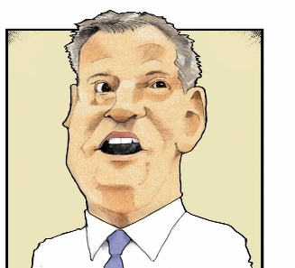

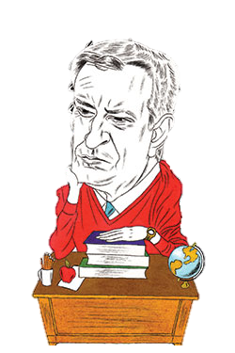

Objectives:
Primarily gauge the preparedness of NYC against a Smallpox based Bio-Terrorist Attack, while considering how long the outbreak will last, the day and quantity of the maximum infected population and the projected death-toll.
Audience:
The answers to these questions will help scientists, the military and policymakers, to prepare contingencies.
Scientists
Military
Policy Makers

Slide 4
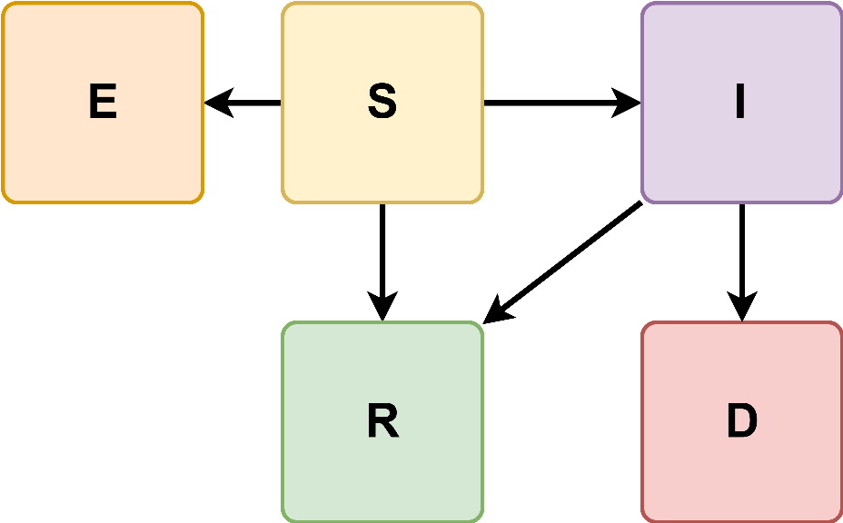
Methodology:
The spread of Smallpox is simulated by an augmented variant of the epidemiological SIR model, which is predictive and deterministic in nature.
Populations Under Consideration:

Slide 5
Methodology: Assumptions
The Smallpox disease has evolved as such, The vaccine only works on the uninfected population.
Acceptable Loss: The acceptable threshold for the death toll is at most 10% of the target population.
Smallpox recovery will take approximately the number of days equivalent to the sum of the contagious phases.
The simulation is considered complete when everyone either recovers or dies.

Slide 6

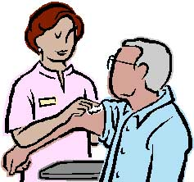

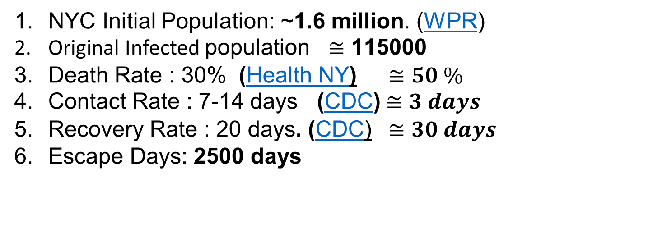
Base: Facts & Figures
NYC Initial Population: ~1.6 million. (WPR)
Original Infected $\text{population} ≅\text{115000}$
Death Rate : 30% (Health NY) $≅50 \%$
Contact Rate : 7-14 days (CDC) $≅3 days$
Recovery Rate : 20 days. (CDC) $≅30 days$
Escape Days: 2500 days
Interventions: Facts & Figures
Vaccinations
Screenings
Education Campaign

Slide 7




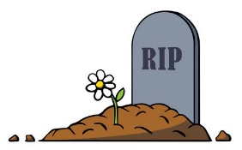
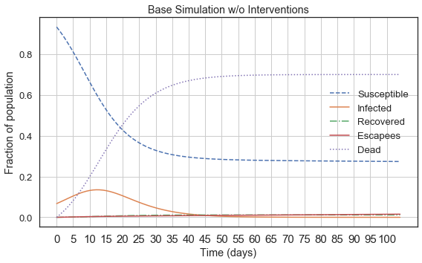


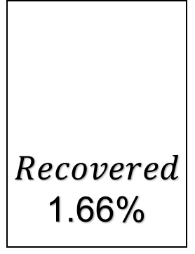


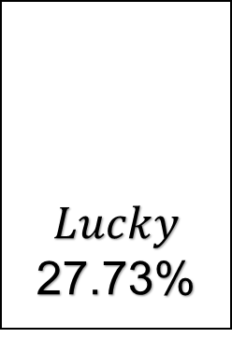
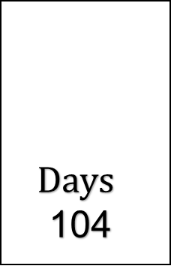
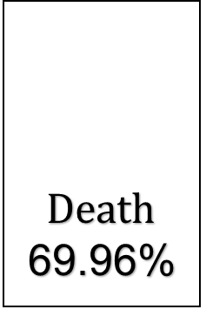
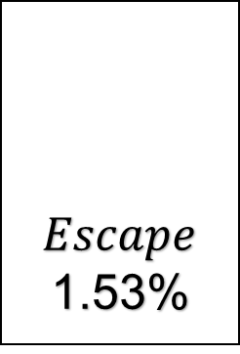
Base Simulation Results
$$Days$$
104
$$Original$$
1715000
$Death$
69.96%
$$Lucky$$
27.73%
$$Inffected$$
71.13%
I
$Recovered$
1.66%
$Escape$
1.53%

Slide 8
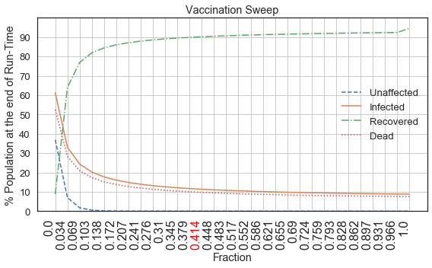
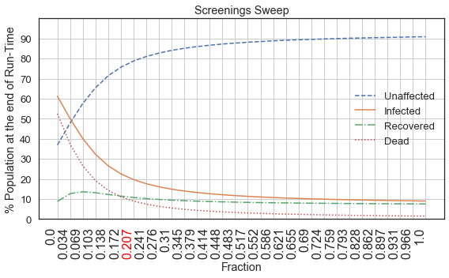
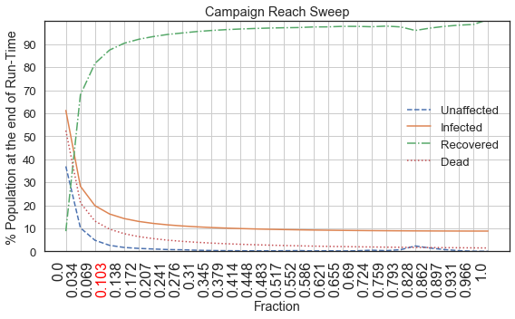
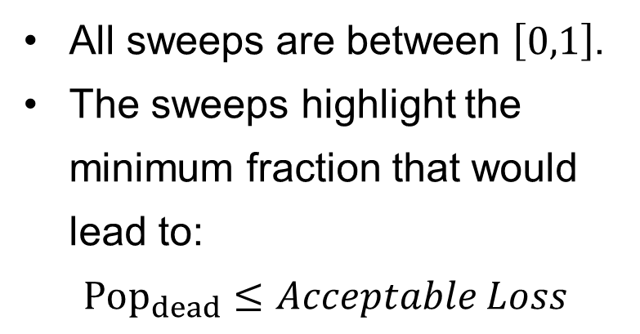
Interventions
Intervention Sweeps
All sweeps are between $\left[0,1\right]$.
The sweeps highlight the minimum fraction that would lead to:
$${Pop}_{dead}≤Acceptable Loss$$

Slide 9
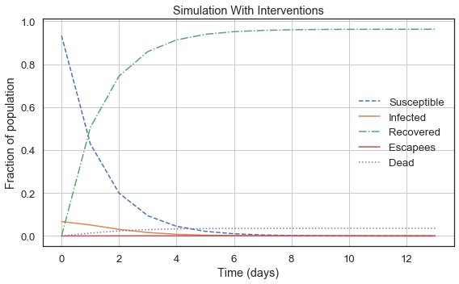
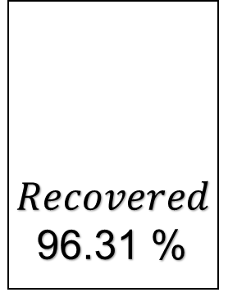
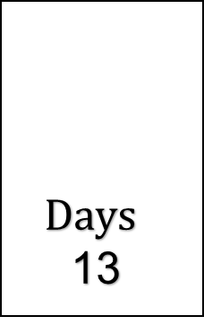
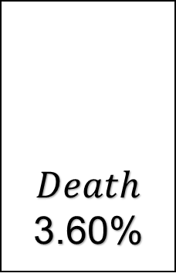
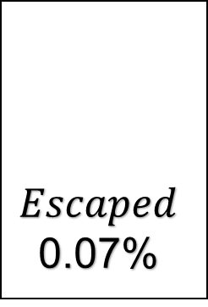
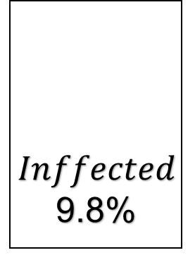
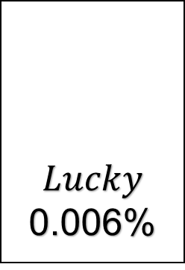
Intervention Results
$$Days$$
13
$$Original$$
1715000
$Death$
3.60%
$$Lucky$$
0.006%
$$Inffected$$
9.8%
I
$Recovered$
96.31 %
$$Escaped$$
0.07%

Slide 10
Conclusions:
Without precautions, NY is vulnerable to an attack.
Our model is general, precise and fruitful.
However, our model is not completely realistic.
Limitations:
Money is not considered.
Interventions disregard HCF.
All rates are constant.
Improvements:
Running costs of interventions.
Interventions such as quarantines
Preemptive interventions e.g vaccinations.

Slide 11
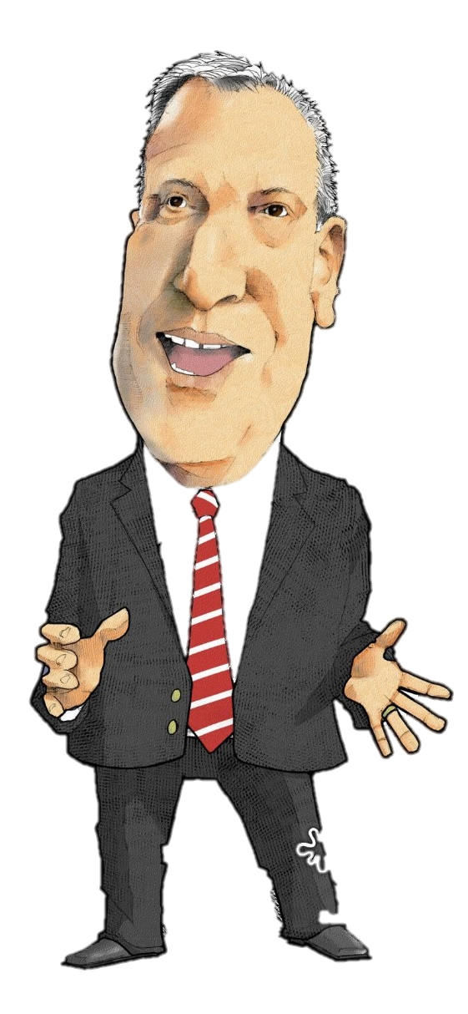
The End
Good job, Guys.
Thank you for showing me the model.

